Slide 1
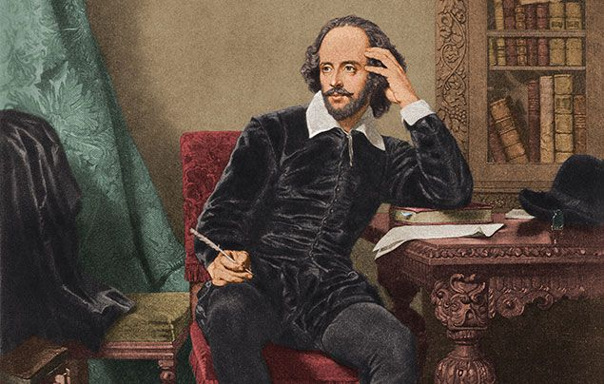
An Introduction to Shakespeare
Quick starter: how many different words can you make from the word ‘Shakespeare’?
Notes:
https://wayground.com/admin/search/shakespeare?term=Shakespeare&tab=final-review&source=SearchHeader&page=SkillsPage&arid=b7318e35-7753-4f5b-a68e-9414036ec76d&apos=-1

Slide 2


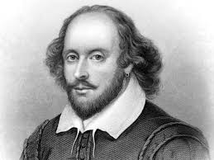
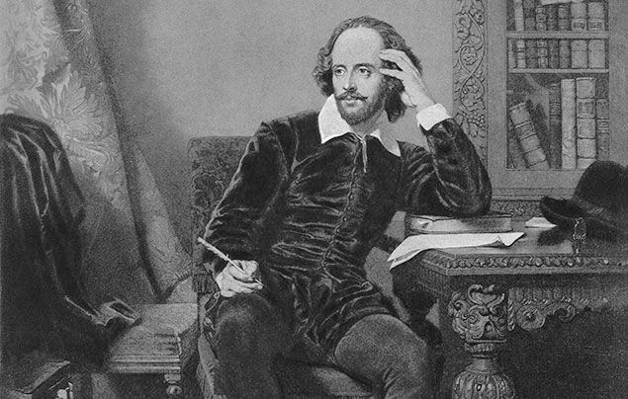


Wayground Shakespeare Quiz
In just a moment, the link and code for joining the Shakespeare Quiz will be displayed. Join and see what you can remember about William Shakespeare!
Notes:
https://wayground.com/admin/search/shakespeare?term=Shakespeare&tab=final-review&source=SearchHeader&page=SkillsPage&arid=b7318e35-7753-4f5b-a68e-9414036ec76d&apos=-1

Slide 3
Task 1: Research facts about Shakespeare
Read and discuss these websites on Shakespeare in pairs:
15 top William Shakespeare facts!
BBC Radio 4 - Homeschool History - 11 surprising facts about William Shakespeare
Be ready to share 1 fact with the class!
Notes:
10 mins to read and research, then 5 mins to share as a class

Slide 4
Task 2: Shakespeare’s Sonnets
Shakespeare was not only famous for plays like Romeo and Juliet. He also wrote many sonnets about love.
Read and explore the famous sonnet by Shakespeare on the next slide in pairs.
Be ready to share in 10 minutes:
What is the poem about?
How many lines?
Any rhyme scheme?
Any meter / rhythm you notice?
Powerful words and images?
Notes:
10 mins to read and discuss sonnet 116, then 5 mins shared class discussion

Slide 5
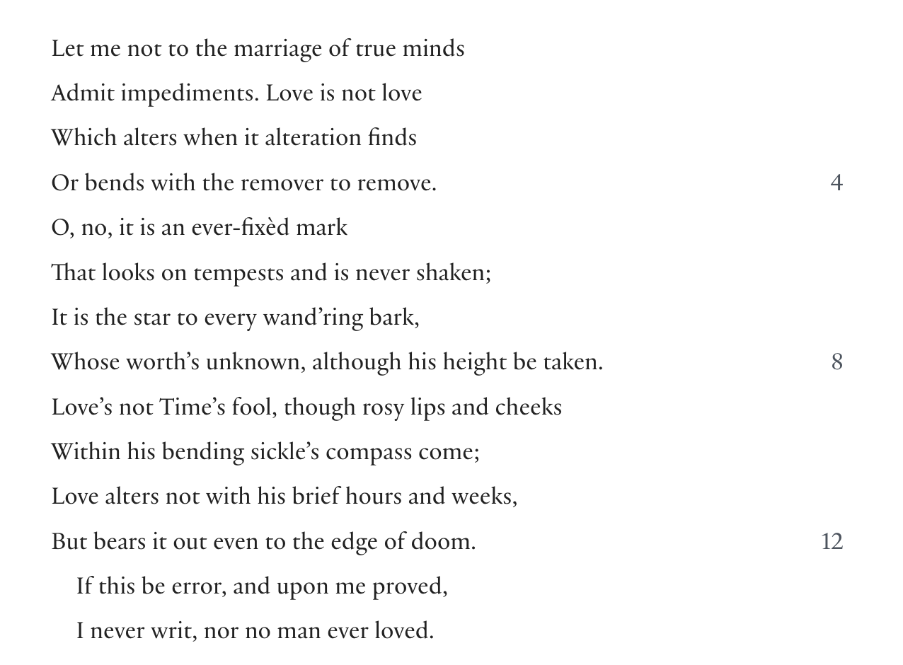
SONNET 116

Slide 6
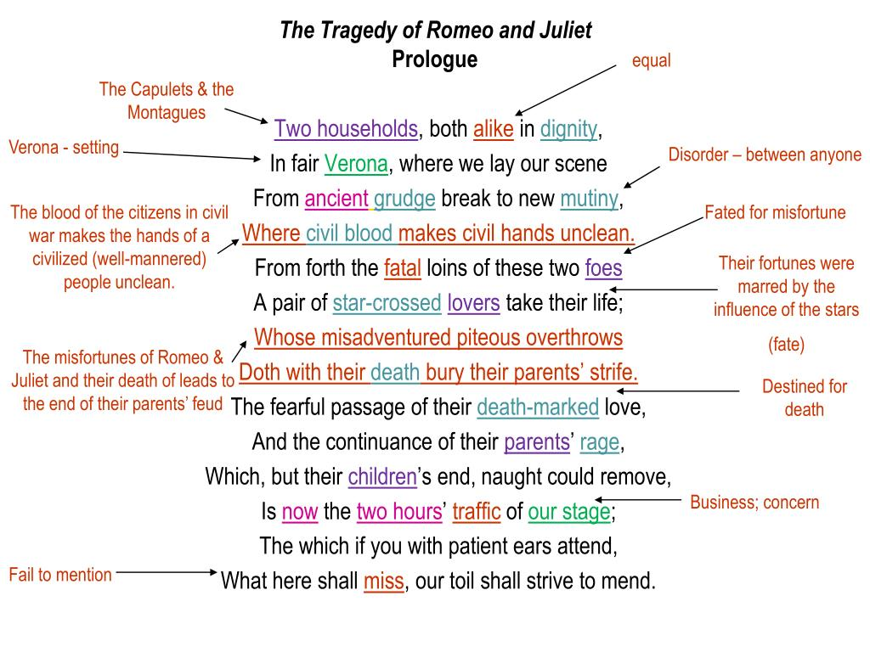
R&J Prologue

Slide 7
Task 3: Write your own sonnet
Create your own Shakespearean sonnet about your favorite hobby. You can create this on paper or on a Google doc or on Canva.
Use this guide to help you follow the rules of sonnet writing:
Poetry 101: What Is a Shakespearean Sonnet? Learn About Shakespearean Sonnets With Examples - 2025 - MasterClass
Notes:
25 mins - hear some as a plenary

